Slide 1
Principles of Finance
FIN200
Banking:
Retail and Corporate

Slide 2
LEARNING OUTCOMES
By the end of this chapter the reader should be able to:
Contrast the following types of banking: retail, corporate, commercial, investment, universal
Describe the core elements of banking and the social functions they serve: deposit taking, lending and payments
Discuss the main types of loans made by banks and the key factors that bankers consider when granting loans
Outline the range of services offered by banks beyond the core banking functions, such as cash management, insurance, stock broking, providing guarantees and help with overseas trade.

Slide 3
LEARNING OUTCOMES (Continued)
Explain the importance of:
  Good liquidity management – ensuring there are sufficient liquid assets to repay obligations falling due to avoid fear of a sudden outflow of cash
  Good asset management skills – banks need to lend money (acquire assets) with the expectation of a low risk of default and in a diversified manner
  Good liability management – finding funds at low cost
  Good capital adequacy management – the buffer of capital provided by shareholders must be at a high enough level to reduce the chance of insolvency problems while balancing the need to make profits by lending
Identify the main sections of a bank income statement and recognise the main measures that are used to judge a bank’s profitability and safety.
(a)
(b)
(c)
(d)

Slide 4
What is banking?
Taking in deposits
Making loans
Providing a payments mechanism
Universal banks
Retail and wholesale commercial banking.

Slide 5
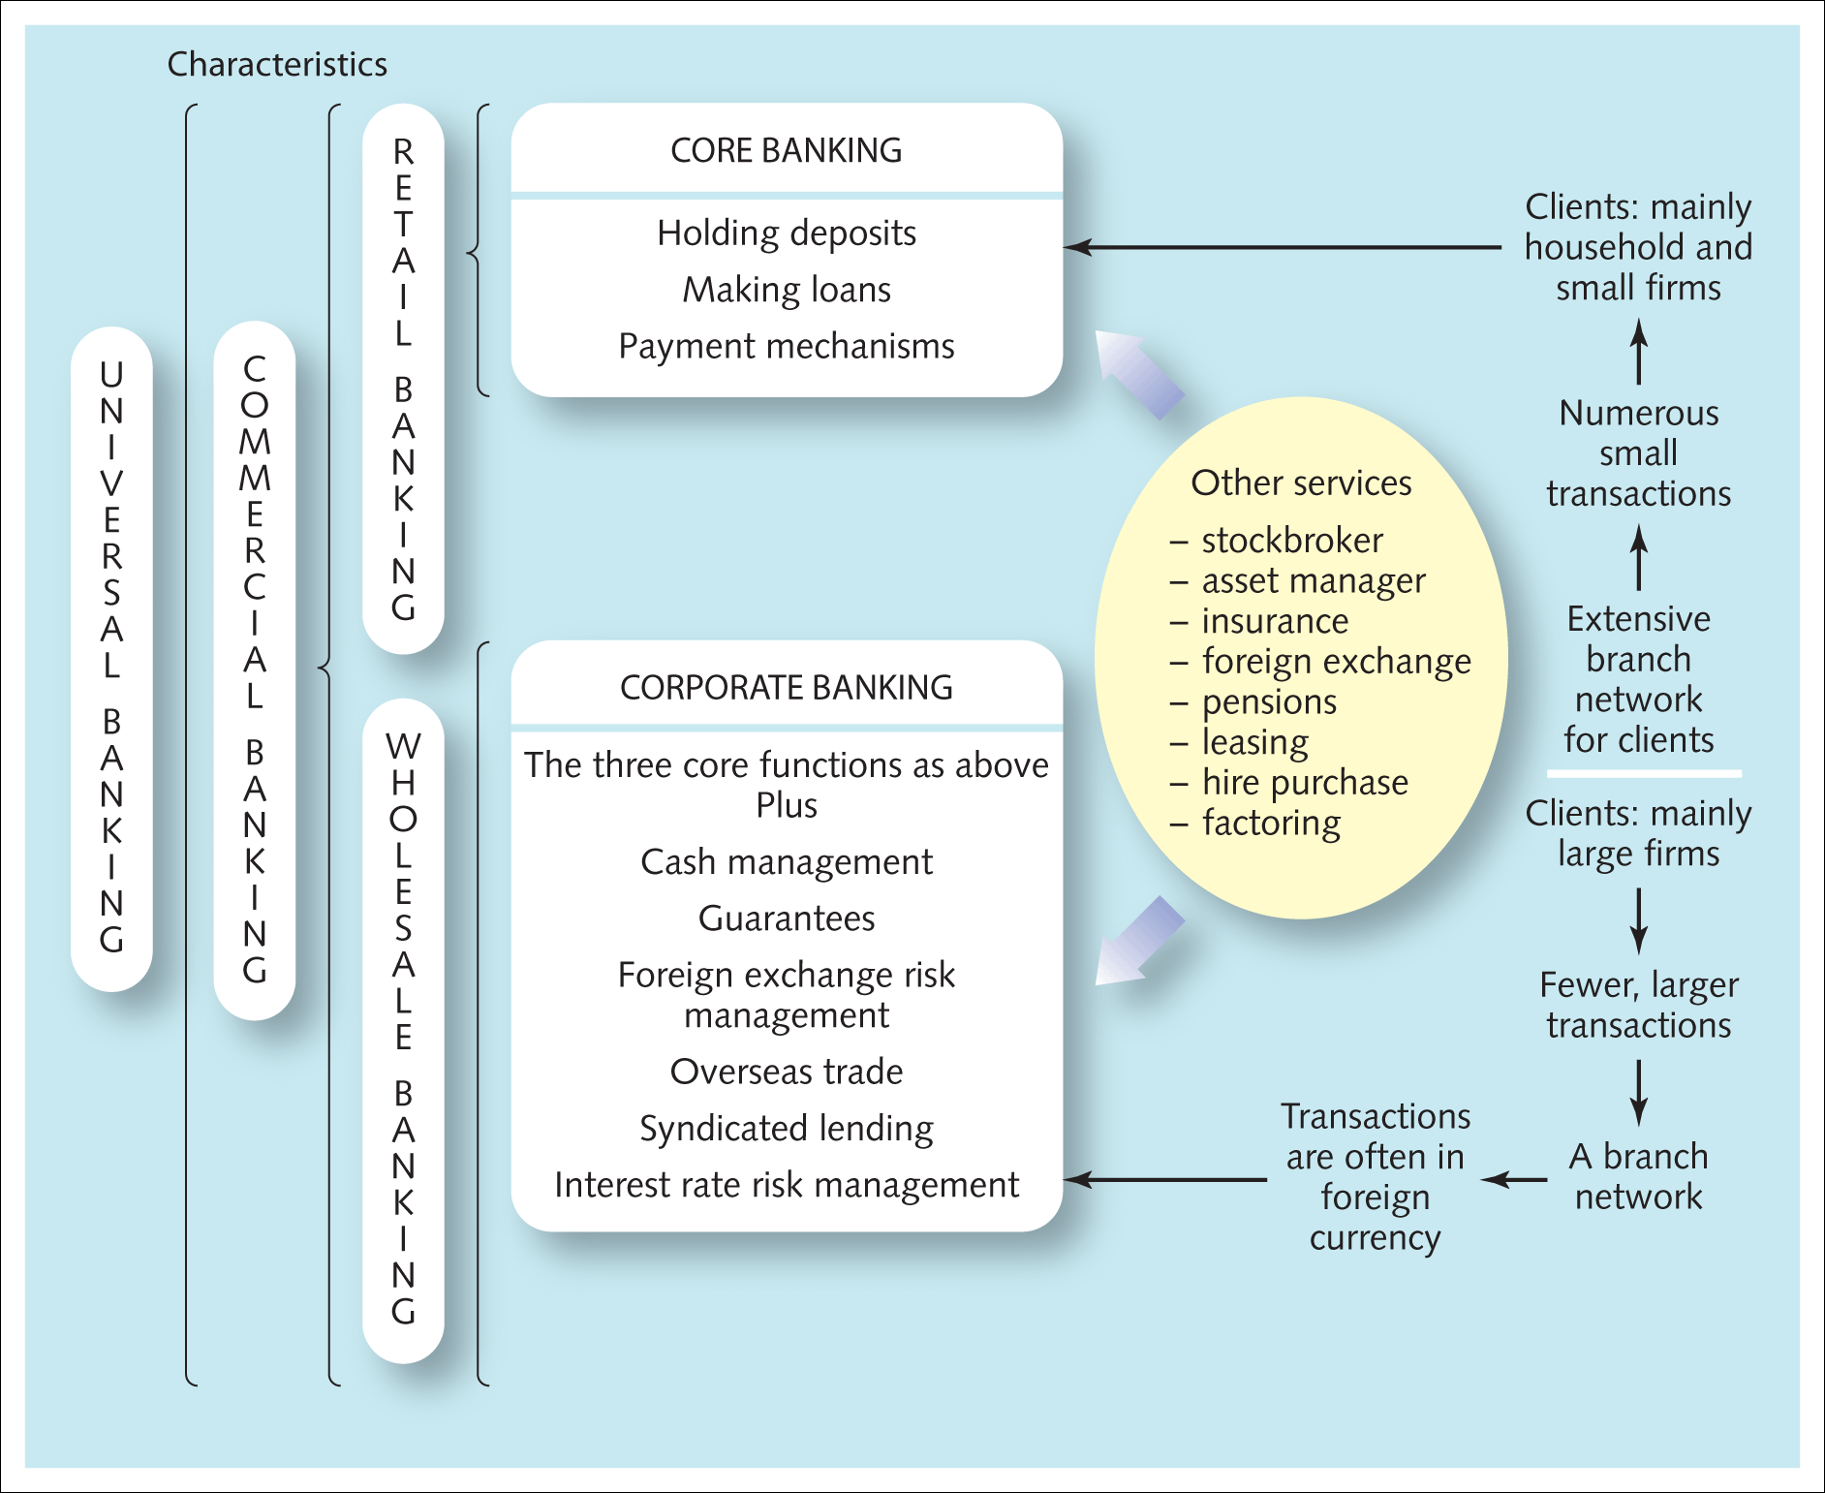
Exhibit 2.1 An overview of the different aspects of banking

Slide 6
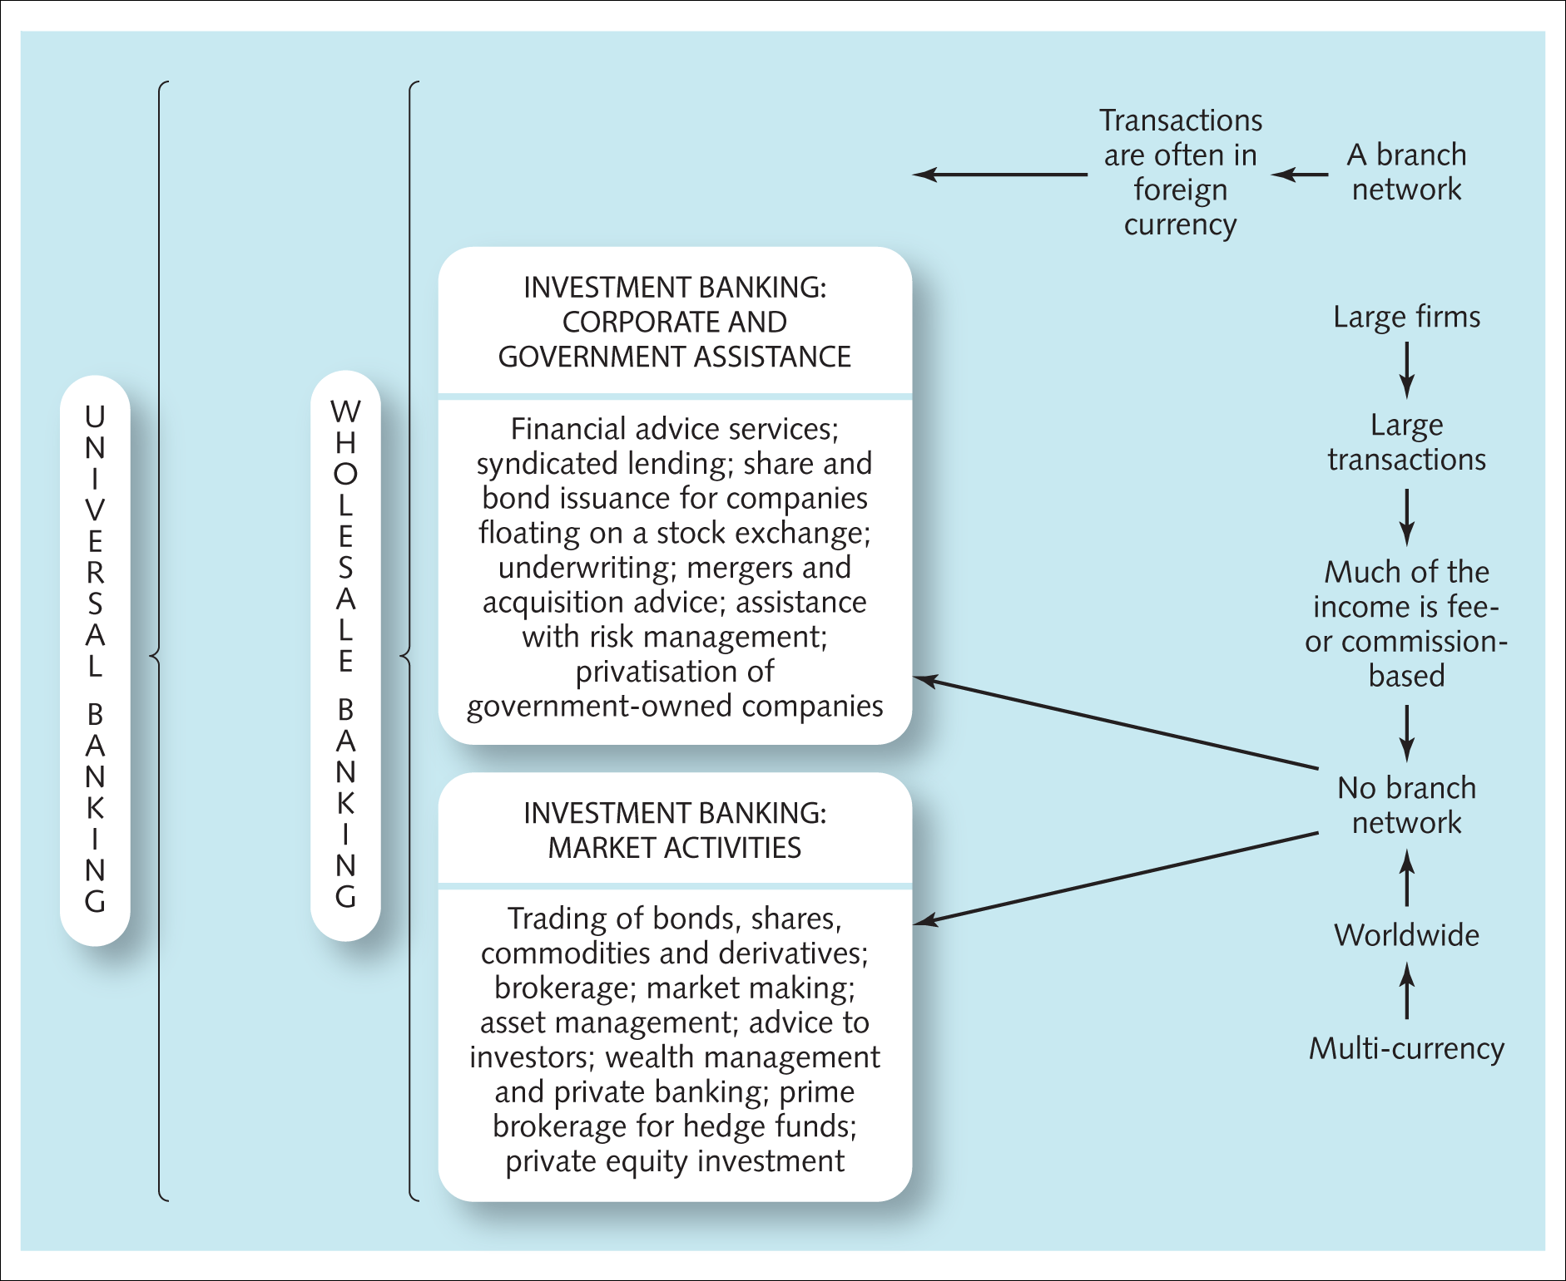
Exhibit 2.1 An overview of the different aspects of banking (Continued)

Slide 7
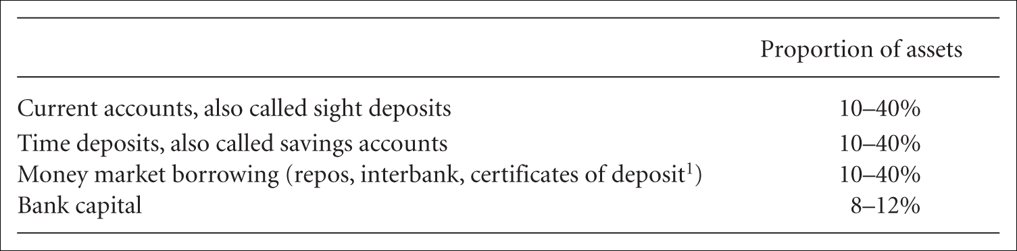
Core banking
Any money deposited (or lent to them via the issue of a financial market security)
Classified as liabilities
Current account (cheque (check) account or sight account)
Time or savings deposit accounts.
Table2.1 The typical liabilities of banks – a rough breakdown

Slide 8
Lending
Techniques to screen and monitor borrowers to reduce risk
Diversify across a range of borrowers
Loans to individuals and to corporations typically account for 50–70 per cent of a commercial bank’s assets
10–35 per cent might be lent out to other banks and institutions in the financial markets on a short-term basis
Some is likely to be invested in long-term government bonds, company preference shares or other long-term investments, but this is usually less than 20 per cent
Between 1 per cent and 10 per cent of the bank’s assets may be in the form of buildings, equipment, software or other assets such as gold
Liquid reserves.

Slide 9
Household lending
Consumer loans (personal loans)
Unsecured
Up to £25,000 if not secured by collateral
Usually repayable within five years
Interest rate is usually fixed at a constant percentage of the outstanding amount throughout the period
Loans secured on property, carry a lower rate of interest
Banks also lend via credit cards.

Slide 10
Lending to businesses
Banks make it attractive for companies to borrow
  Administrative and legal costs are low
  Speed
  Flexibility
  Availability to small firms.

Slide 11
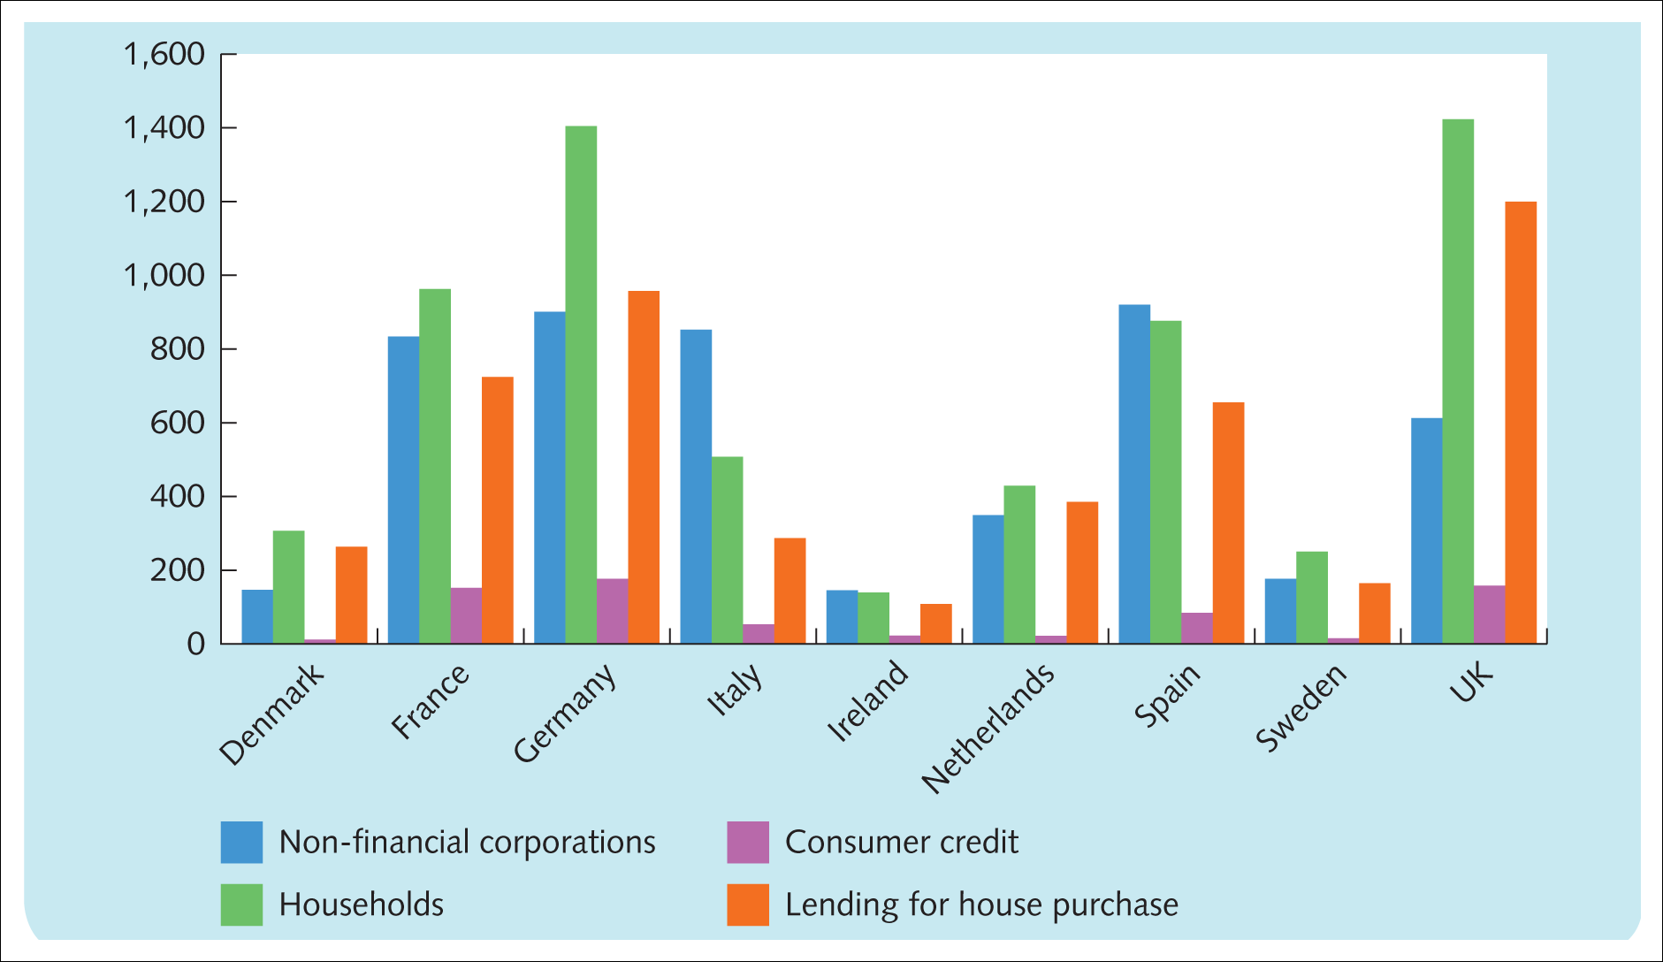
Businesses lending
Arrangement fee
Interest rate can be either fixed or floating (variable)
Base rate or LIBOR
1 per cent (100 basis points, bps).
Exhibit 2.3 Lending by financial institutions (mostly banks) in selected European countries to businesses and to households – amounts outstanding 2010 (household lending is further broken down to consumer credit and house mortgages) (€ billion)
Source: European Central Bank.

Slide 12
Overdraft
An arrangement to take more money out of a bank account than it contains
Few months or a year
Interest is charged on the excess drawings
Advantages
  Flexibility
  Cheapness
Drawback
  Right to withdraw the facility at short notice.

Slide 13
Term loans
A business loan with an original maturity of more than one year and a specified schedule of principal and interest payments
May or may not be secured with collateral
Not being repayable at the demand of the bank at short notice
Bank can be very flexible with regard to the conditions
Grace period or repayment holiday
‘Balloon’ payment structure
‘Bullet’ repayment
Self-amortising term loans
Instalment arrangement
Mortgage-style repayment schedule.

Slide 14
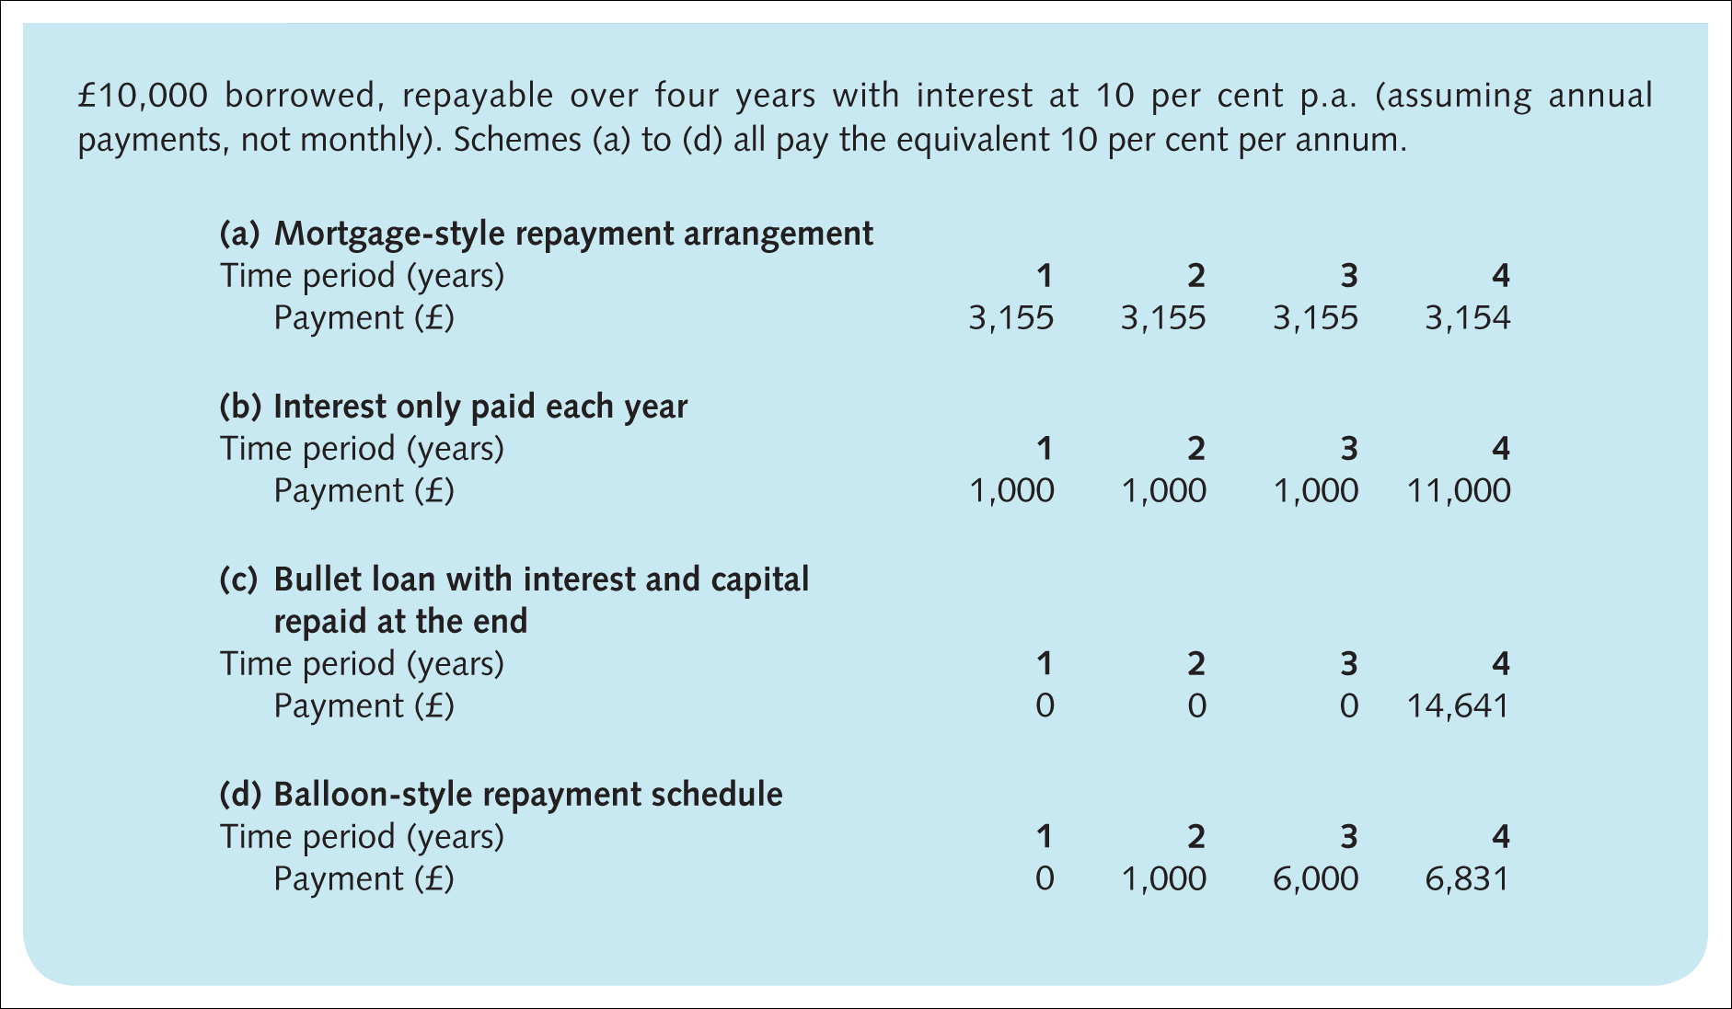
Exhibit 2.4 Simple examples of loan repayment arrangements

Slide 15
Security for banks on business lending
Borrower’s competence and honesty
Evaluate the proposed project
Why the funds are needed
Detailed cash forecasts covering the period of the loan
Asymmetric information in which one party in the negotiation is ignorant of, or cannot observe, some of the information which is essential to the contracting and decision-making process.

Slide 16
Collateral
A means of recovering all or the majority of the bank’s investment should the firm fail to repay as promised
Fixed-charge collateral
Floating charge
Liquidation analysis
Going concern
Stocks (inventories) of unsold goods, debtors and equipment, land, buildings and marketable investments such as shares
Careful to create a margin for error in the assignment of sufficient collateral.

Slide 17
Loan covenants
Limits on further debt issuance
Dividend level
Limits on the disposal of assets
Financial ratios.

Slide 18
Other security measures
Guarantees from third parties
Personal guarantees
Creditworthiness
The amount that the borrower is prepared to put into the project or activity, relative to that asked from the bank.

Slide 19
Payment mechanisms
Cheque
Giro
Standing orders and direct debits
Plastic cards
Landlines and mobile phones
Internet.

Slide 20
Corporate banking
Uncommitted facilities
The bank does not enter an agreement that makes it obliged to provide funds at the borrower’s request and the facility can be cancelled and so the borrower may have to repay at short notice
Overdraft
Rolled over or revolved
Uncommitted line of credit
Banker’s acceptance.

Slide 21
Committed facilities
The lender enters into an obligation to provide funds upon request by the borrower, provided any agreed conditions and covenants in the loan agreement have been and are being met
Commitment fee
Revolving credit (revolving credit facility, RCF)
Allows the borrower to both draw down the loan in tranches and to reborrow sums repaid within the term of the facility so long as the committed total limit is not breached
One and five years
Usually unsecured lending
Payments based only on the amount they’ve actually used or withdrawn, plus interest
Front-end or facility fees
Commitment fees.

Slide 22
Project finance
Equity capital for a separate legal entity (a ‘special purpose vehicle’, SPV)
Formed to build and operate a project, for example an oil pipeline, an electricity power plant
Project finance loan is then provided as bank loans or through bond issues direct to the separate entity
Returns are tied to the cash flows and fortunes of a particular project rather than being secured against the parent firm’s assets
Project needs to be easily identifiable and separable from the rest of the company’s activities
Recourse finance
High transaction and legal costs.

Slide 23
Salient points of project finance
Transfer of risk
Off-balance-sheet financing
Political risk
Simplified banking relationship
Managerial incentives.

Slide 24
Syndicate lending
A few banks each contribute a portion of the overall loan
Lead manager
Co-manage the loan
Syndicate group of banks in the general syndication
Managing bank also underwrites
Available at short notice
Commitment fees, underwriting fees, agent’s fee.

Slide 25
Revolving underwriting facility and note issuance facility
Commercial paper or medium-term notes
An arranging bank
A currency that suits the borrower at the time
Select the length of life of the paper
Whether it pays fixed or floating interest rates
Underwriters guarantee that someone will buy the issue.

Slide 26
Other corporate banking activities
Cash management
Guarantees
Overseas trade
Letter of credit
Forfaiting
Foreign exchange risk management and interest risk management.

Slide 27
Other commercial banking services
Stockbroking
Asset management
Custody and safety deposits
Insurance and pensions
Foreign exchange
Asset-based lending.

Slide 28

How a bank operates
Shareholders’ funds
  Shareholders do not have the right to withdraw their
  money from the company – it is permanent capital
Making profits for its shareholders and deciding to keep it within the business
Selling more shares.

Slide 29
Liquidity risk
BarcSan
Required by the central bank (its regulator) to hold 8 per cent of the value of its current account deposits in reserves - regulatory required reserves
4 per cent of the value of its current account liabilities as excess reserves
Reserves consist of both the cash (notes, etc.) that the bank is required to hold in its account with the central bank plus cash (notes, etc.) that it has on its own premises, referred to as vault cash
‘Liquid reserves’.

Slide 30
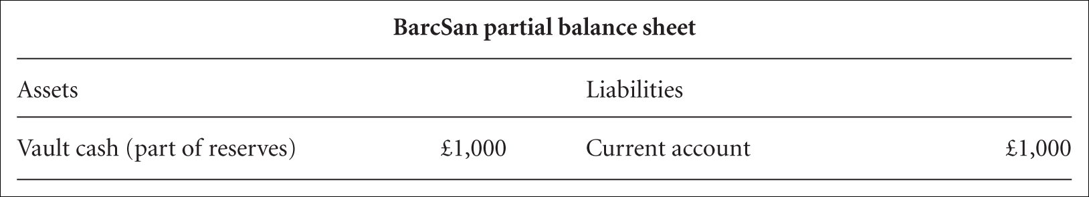
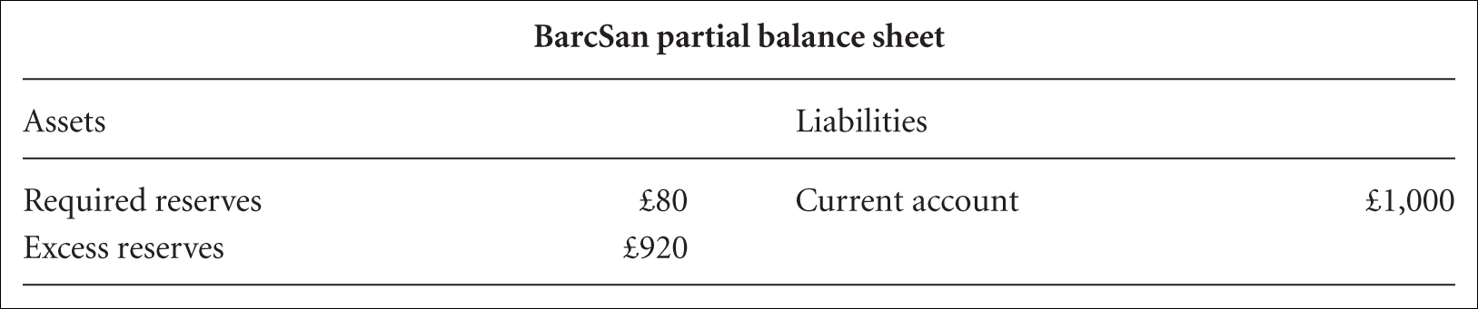
Example
Mrs Rich deposits £1,000 of cash into her current account at the BarcSan Bank.

Slide 31
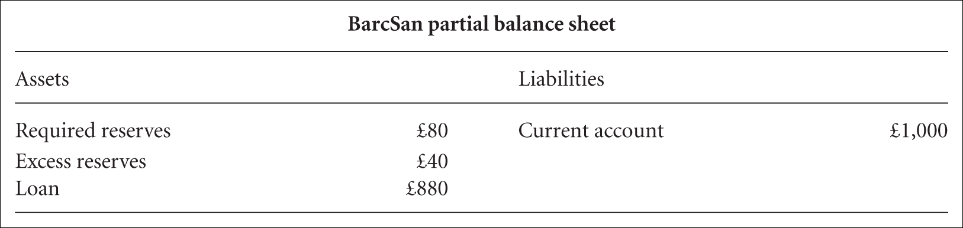
Barcsan Example
The bank lend £880.

Slide 32
Key bank management skills
Liquidity management
Asset management skills
Liability management
Capital adequacy management.

Slide 33
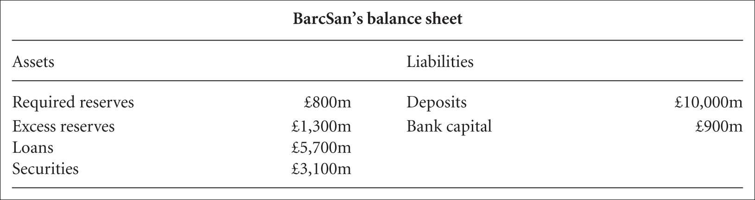
Liquidity management and reserves
Balance sheet for BarcSan as a whole.

Slide 34
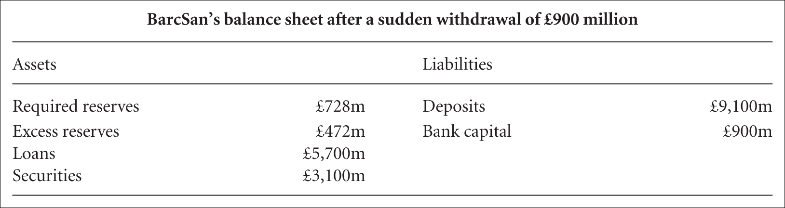
Liquidity management and reserves (Continued)

Slide 35
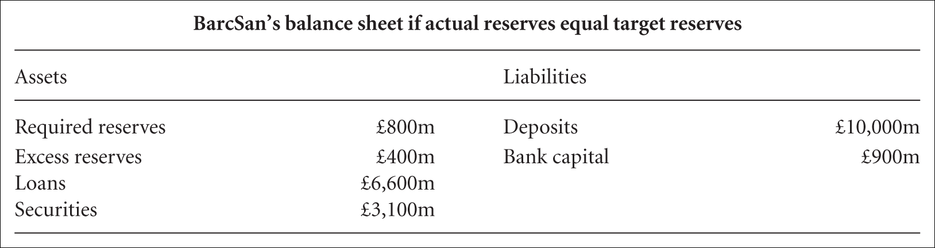
Liquidity management and reserves (Continued)

Slide 36
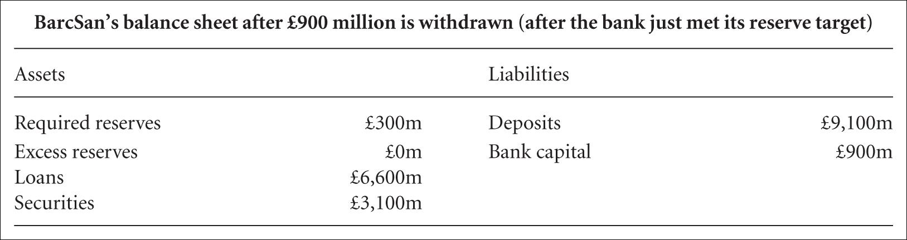
Liquidity management and reserves (Continued)

Slide 37
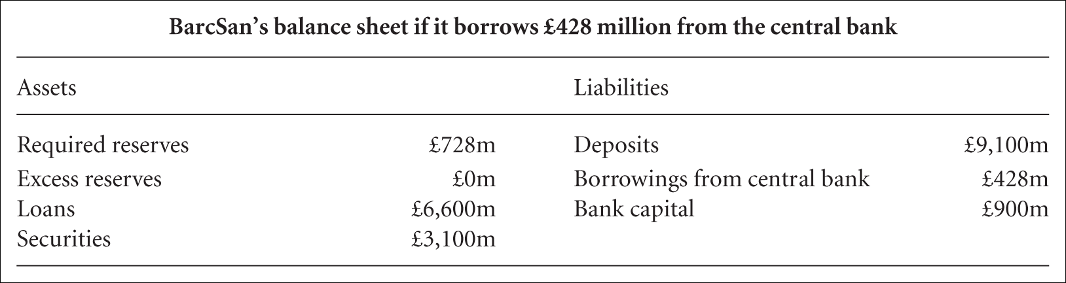
Where is it going to get the shortfall from?
Borrowing from the central bank.

Slide 38

Securities could be sold.

Slide 39
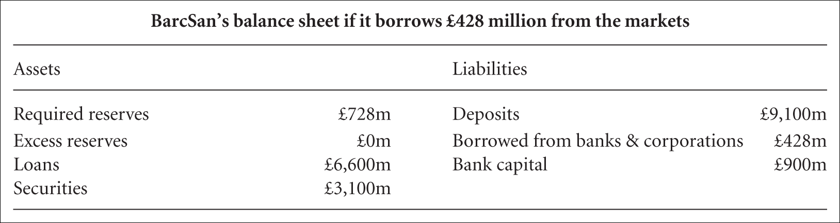
Borrow from other banks and other organisations.

Slide 40
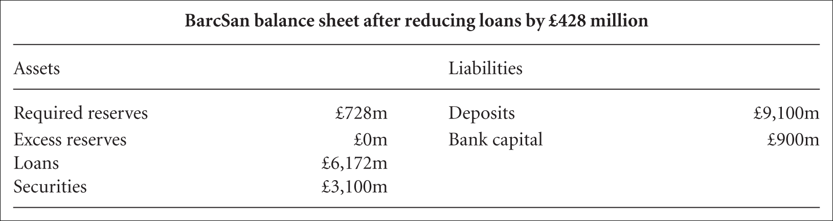
Reducing its loans.

Slide 41
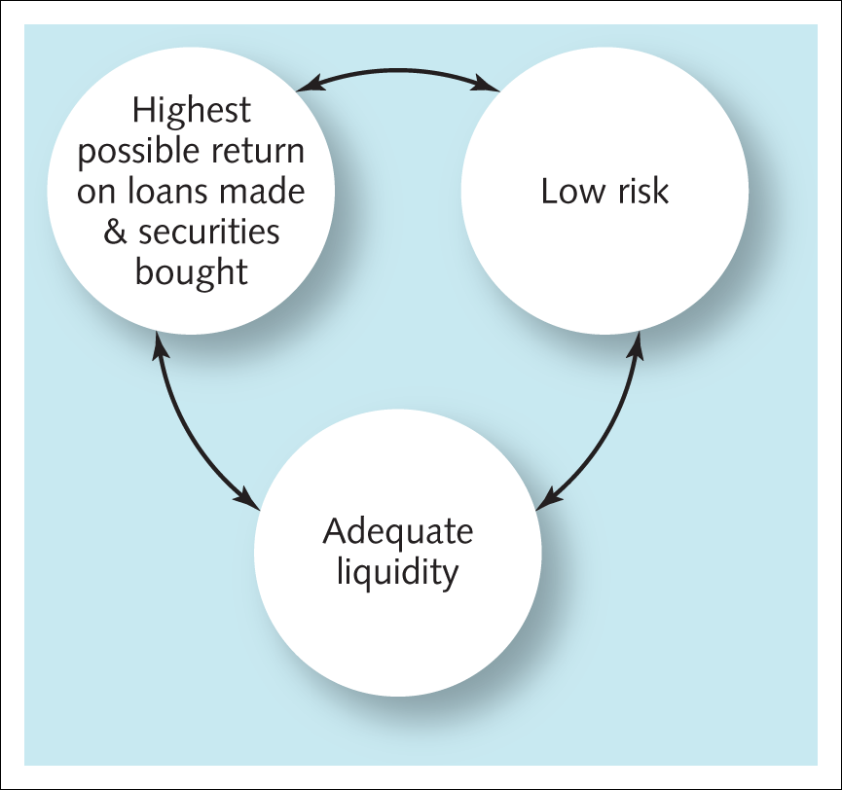
Asset and liability management
Liability management is focused on the judgements made about the composition of liabilities as well as the adjusting of interest rates offered to lenders to the bank to obtain the target mix of borrowing.
Exhibit 2.8 The three objectives to be traded off in asset management

Slide 42
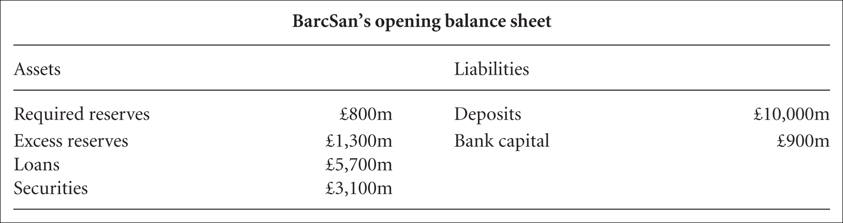

Capital adequacy management
Fear of insolvency – an inability to repay obligations over the longer course of events – rather than illiquidity, which is insufficient liquid assets to repay obliga-tions falling due if there is a sudden outflow of cash. BancSan’s capital to assets ratio is £900 million/£10,900 million = 8.3 per cent. Mercurial ratio of capital to assets is 3.7 per cent (£400 million/£10,900 million).

Slide 43
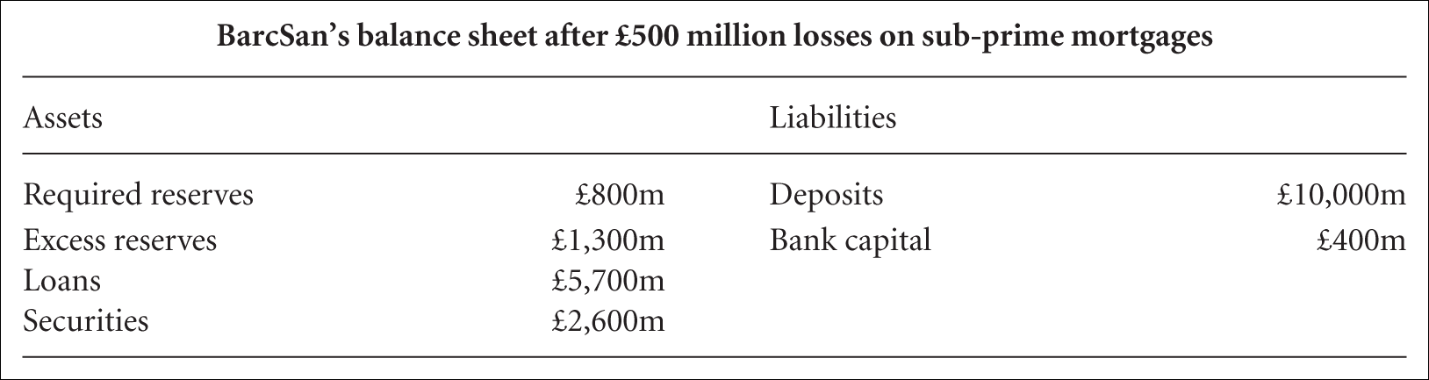

Both banks have invested £500 million in bonds which are backed by US sub-prime mortgages. These become worthless
Capital-to-assets ratio has fallen to a less conservative 3.8 per cent (£400 million/£10,400).

Slide 44
Why might banks sail close to the wind in aiming at a very low capital-to-assets ratio
Return on assets (ROA)
Net profit after tax
ROA =
Total assets
Both firms’ £150 million/£10,900 million = 1.38 per cent return on equity (ROE).
Net profit after tax
ROE =
Equity Capital
For BarcSan:
ROE =
£150m
= 16.7%
£900m
For Mercurial:
£150m
ROE =
= 37.5%
£400m

Slide 45
Income statements
Income:
  Interest income
    Non-interest income
Operating expenses:
    Interest expense
    Non-interest expense
    Provisions for loan losses
Gains (or losses) when the bank sold securities in the financial markets
‘Extraordinary items’.
(a)
(b)
(a)
(b)
(c)

Slide 46
Key measures of bank performance
Net interest margin (NIM):
Interest income – Interest expense
NIM =
Assets
Loan-to-deposit ratio
Cost–income ratio (C/I).
Cost
Non-interest expenses
=
Income
Net interest income + Non-interest income

